Slide 1
SP-Project
FourYear Transforms

Slide 2
Part-1

Slide 3
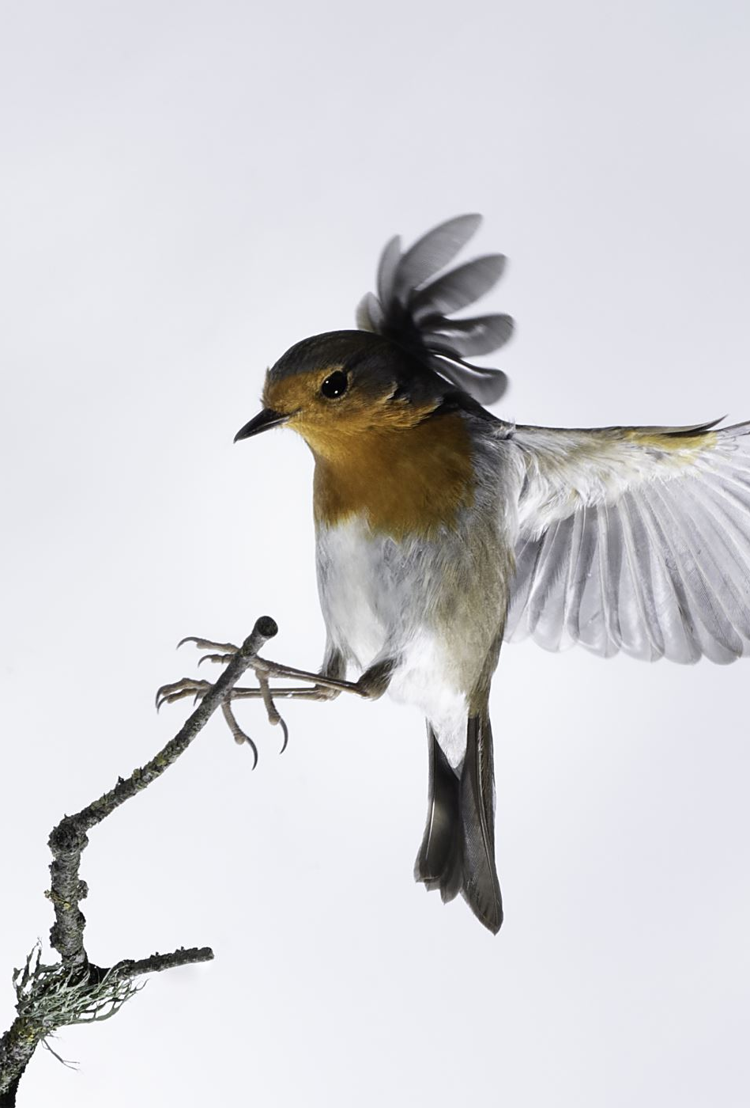
Problem statement
We are Given Audio Samples of 3 Birds and by Analysis of those that we have to Predict Bird in the Given Test Audios

Slide 4
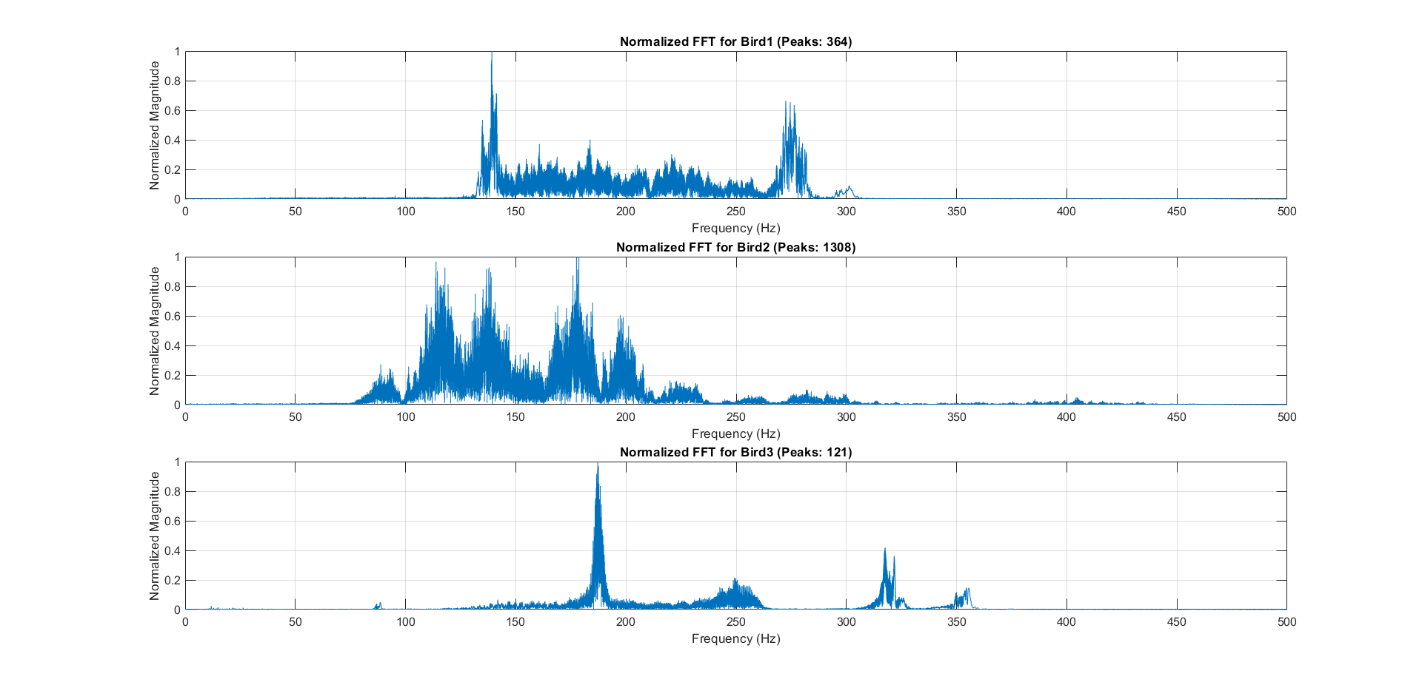
FFT of given samples

Slide 5
Method to distinguish
To distinguish we need to Compare the Nature of FFTs of given samples with the Test Samples and Identify the Bird
So by oberseving the FFTs we can Differentiate them on the basis of Peaks
We normalise the FFT magnitude and Analyse no. of peaks above a certain threshold.

Slide 6

Method
After Plotting FFT of given Samples, we observe that we can distinguish them based Number of Peaks in Normalised FFT
We choose a Threshold for our Analysis and We can say that if our Test Audio has 0-130 Peaks it is Bird1,if it has 130-400 Peaks it is Bird 2 and if more than this it is Bird 3

Slide 7
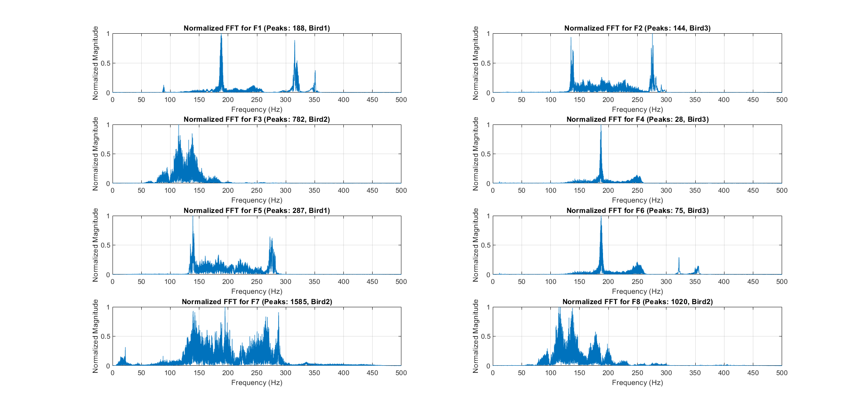
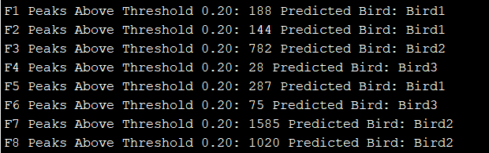
Final Result
Our Code has predicted the Species in Test Samples F1-F8
It can be verified by Observing The FFT plots of those Test Samples

Slide 8
Part-2

Slide 9
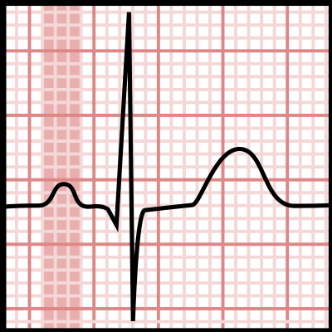
Problem statement
We are given 3 ECG waves, out of which 2 are noisy
We are tasked to find out the heart rate estimations per minute for each of these ECG waves.

Slide 10
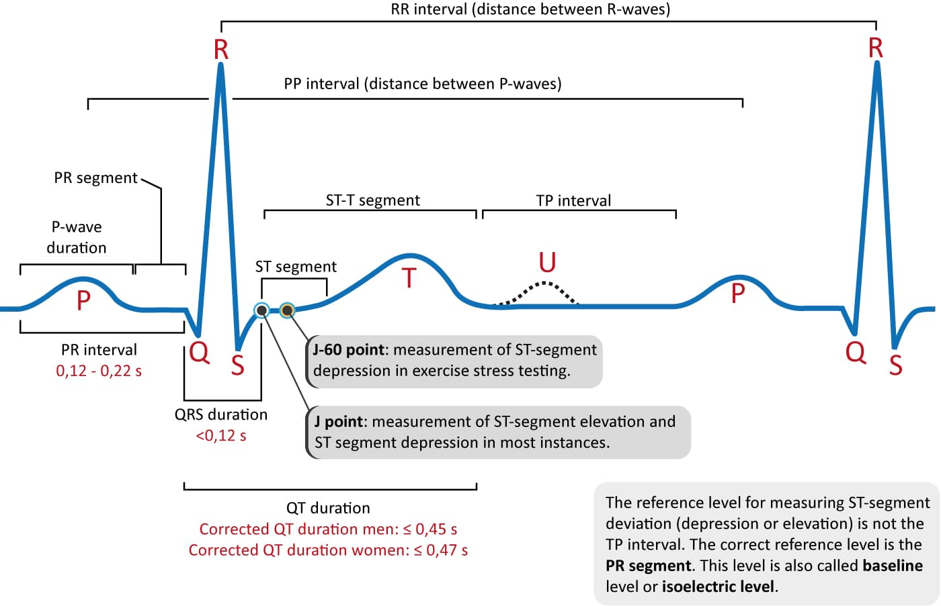
HR from ECG
In every task we have to find out the heart rate (HR) estimation from ECG wave(s).
From ECG graph we can deduce the heart rate by finding out the RR interval
HR = 60/RR_interval

Slide 11
ECG_HRConverter
To help with this task, we made a function named ECG_HRConverter.
This function finds R peaks using findpeaks function in matlab and then calculates the heart rate.
This heart rate is averaged out every minute and populates a vector which will be our output

Slide 12
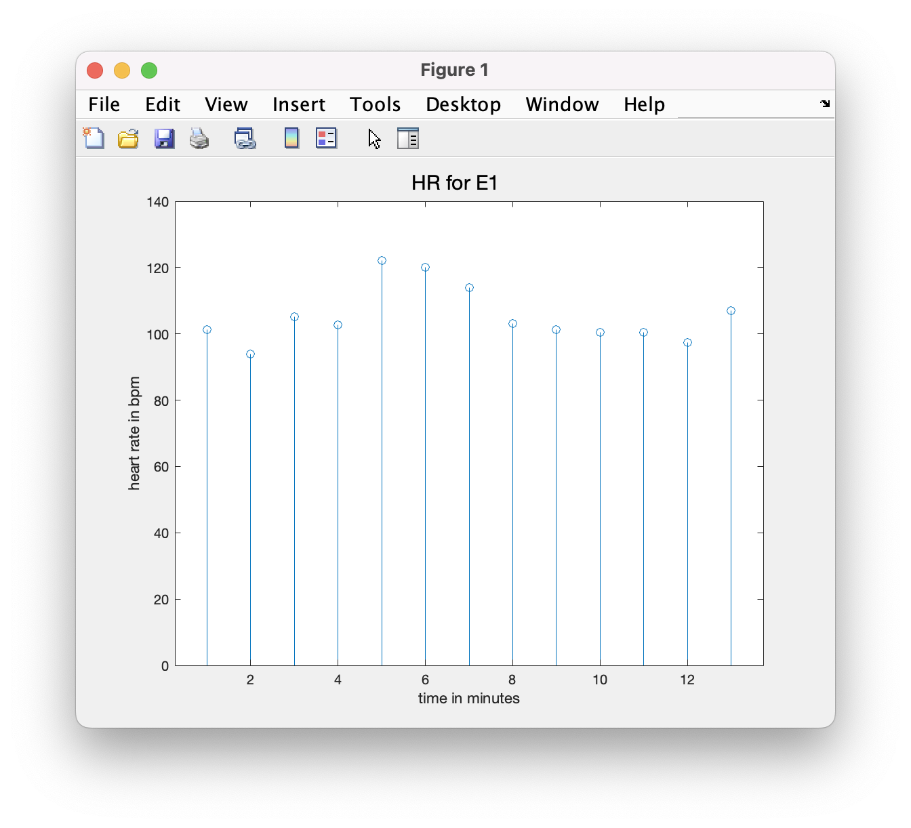
Task-1
In this task we are required to find out HR for a non noisy ECG E1.
This is a straight forward task, when we employ our custom built function.

Slide 13
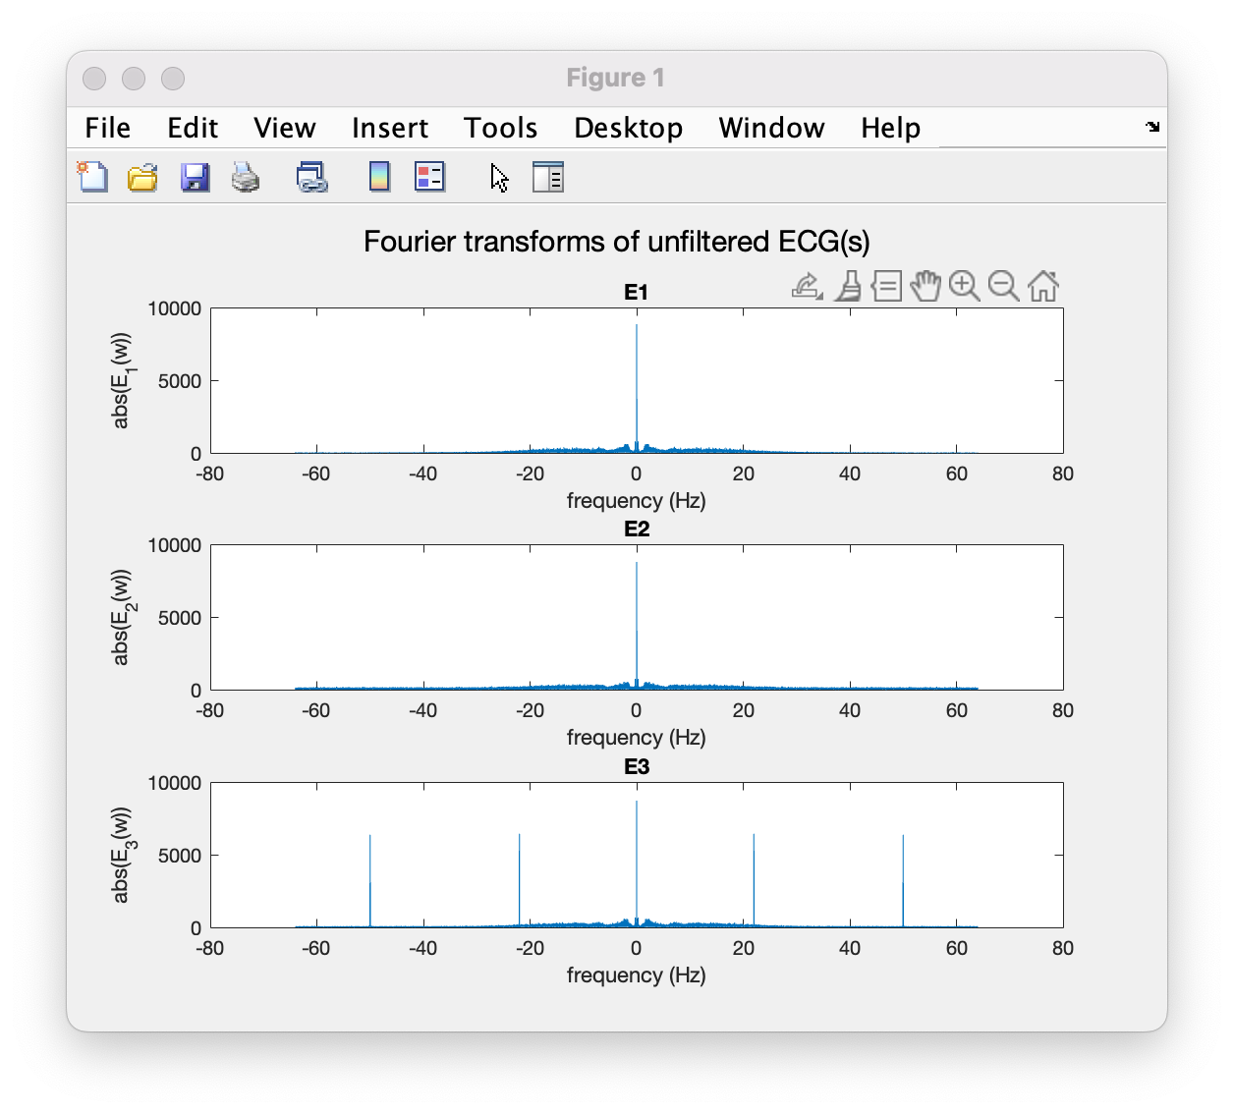
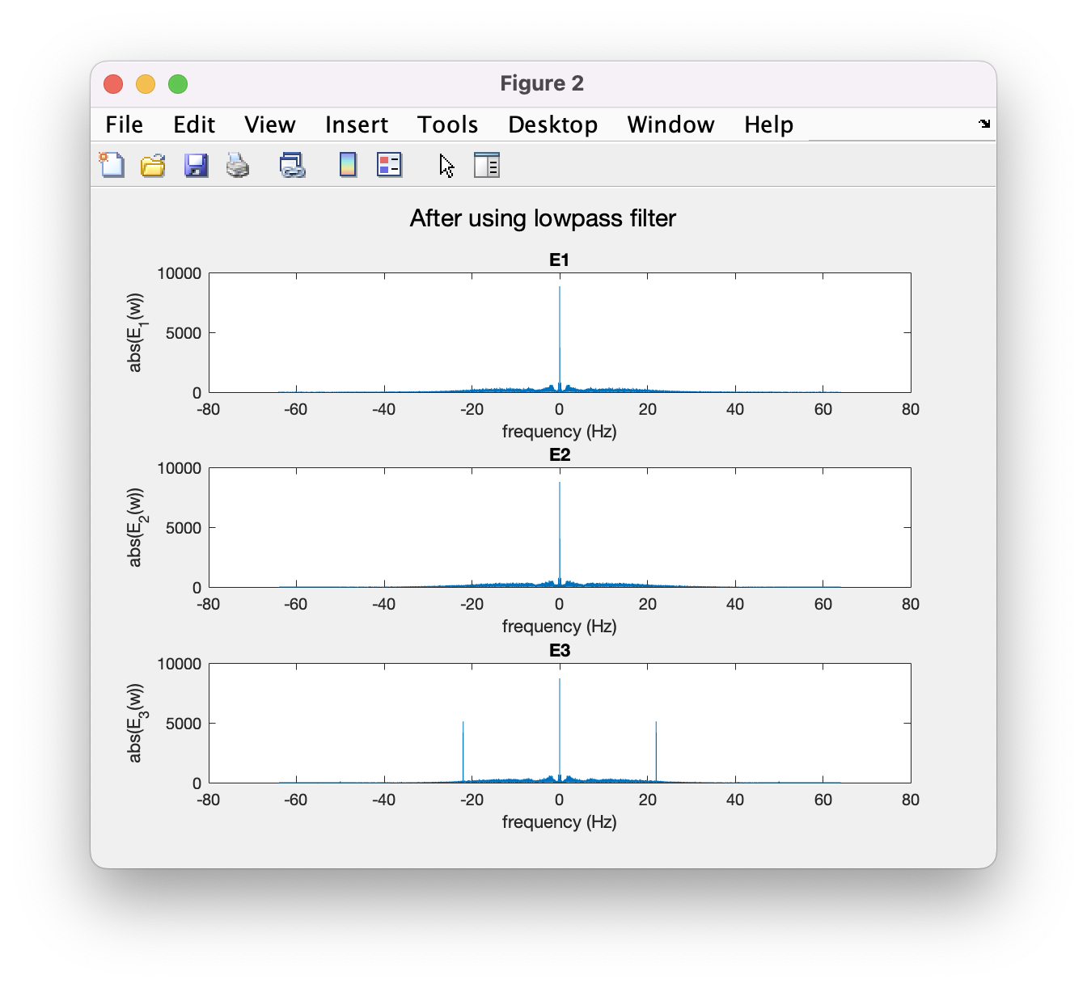
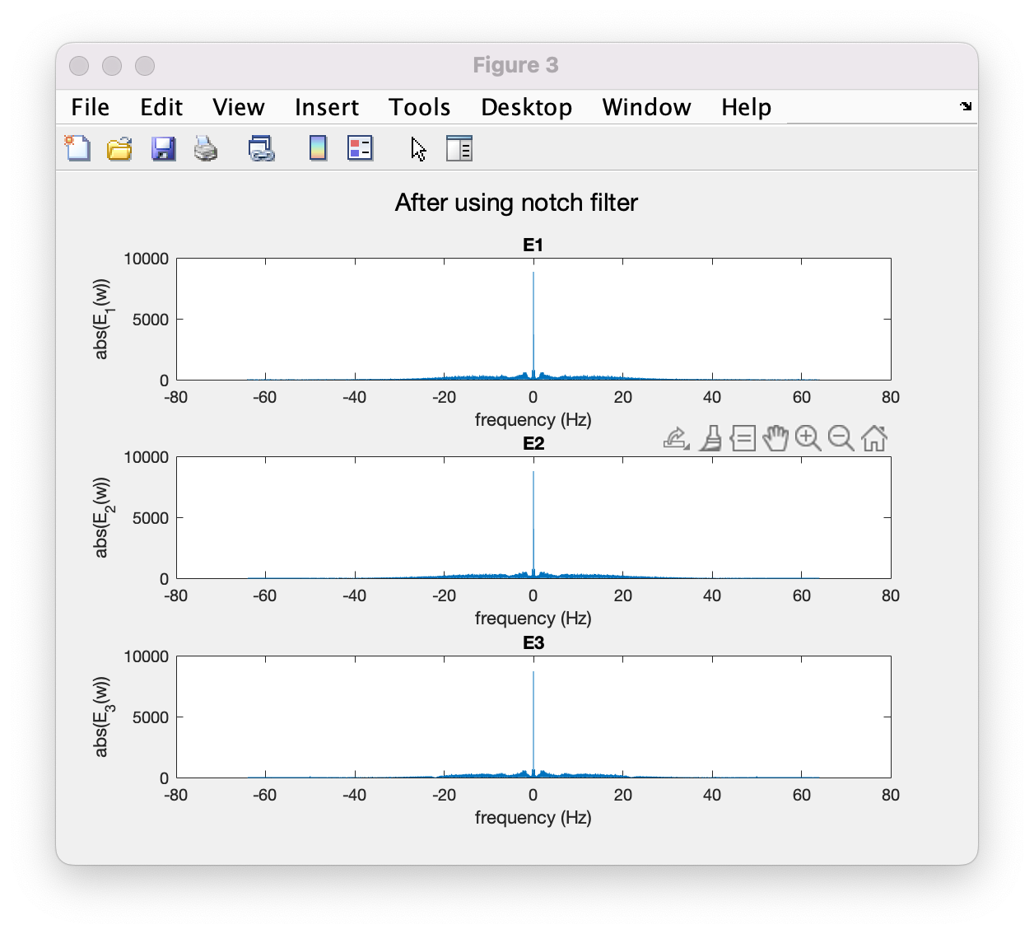
Task-2
Both E2 and E3 signals are noisy. This becomes apparent when we take a look at its FFT.
A low pass filter with cutoff frequency 30hz is enough to filter E2
An additional notch filter for 22hz is employed for E3.

Slide 15
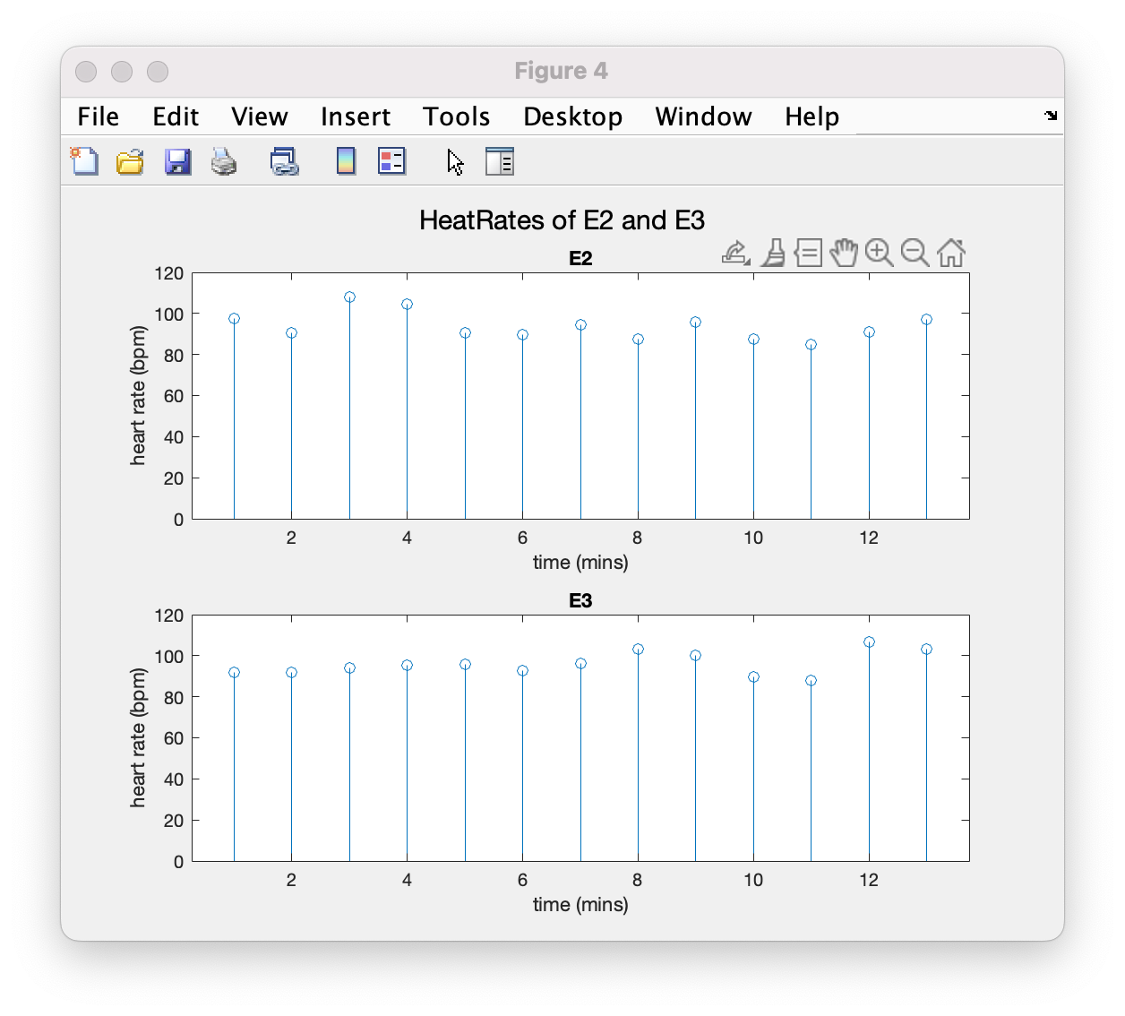

Slide 16
Part-3

Slide 17
Problem statement
For Task-1, we are finding the louder words in the given audio samples using the start and end times.
For Task-2, we are finding the louder words in the given audio samples without using the start and end times.

Slide 18
Task-1
For first subtask I am first finding rms energy of each word using its start time and end time .
Then I am setting a threshold value which filters out the loud words from other words.
Then I have plotted all the words in a histogram where words marked red are having high sounds

Slide 19
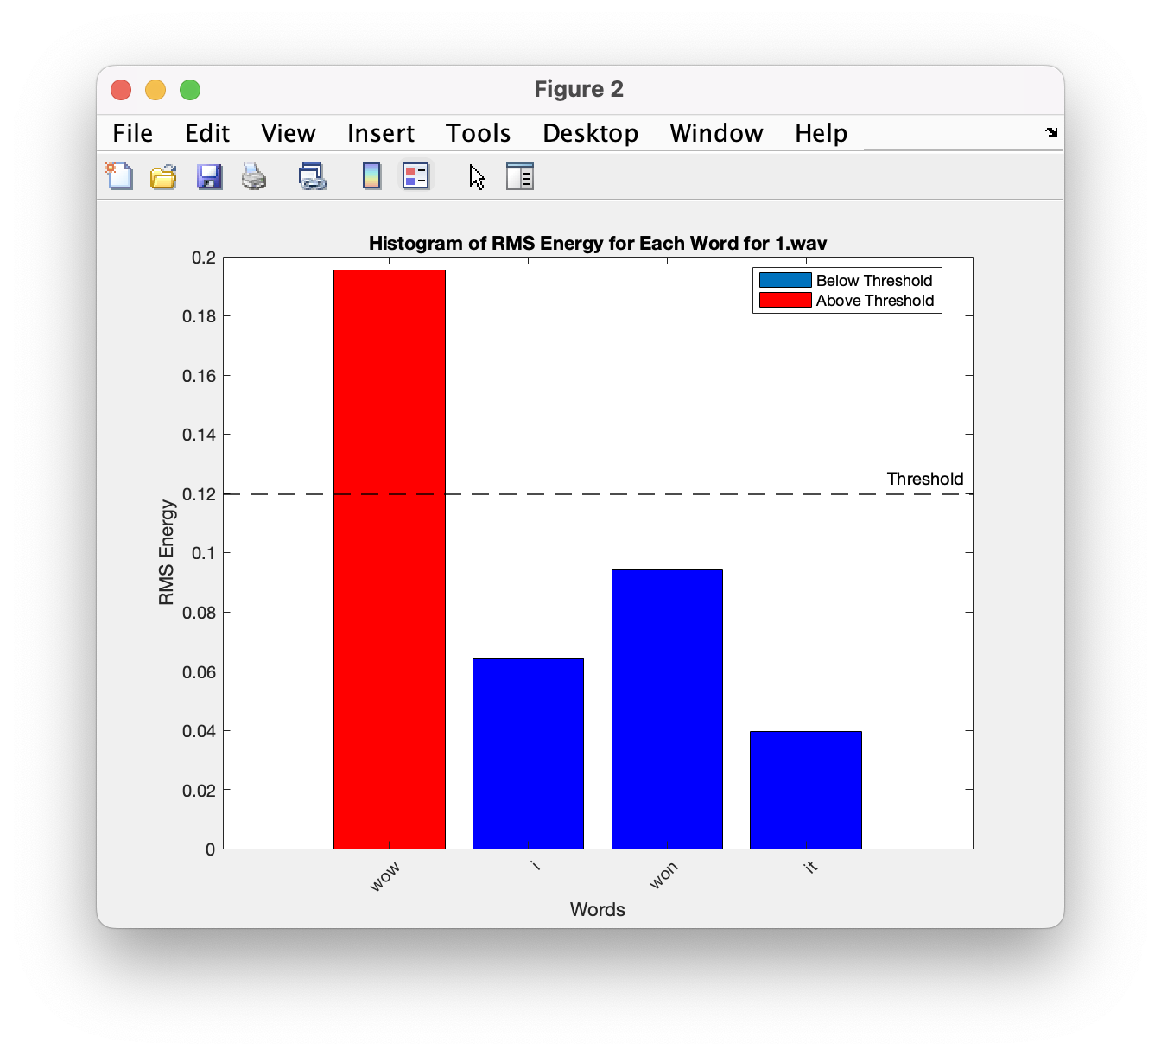
task-1 results

Slide 20
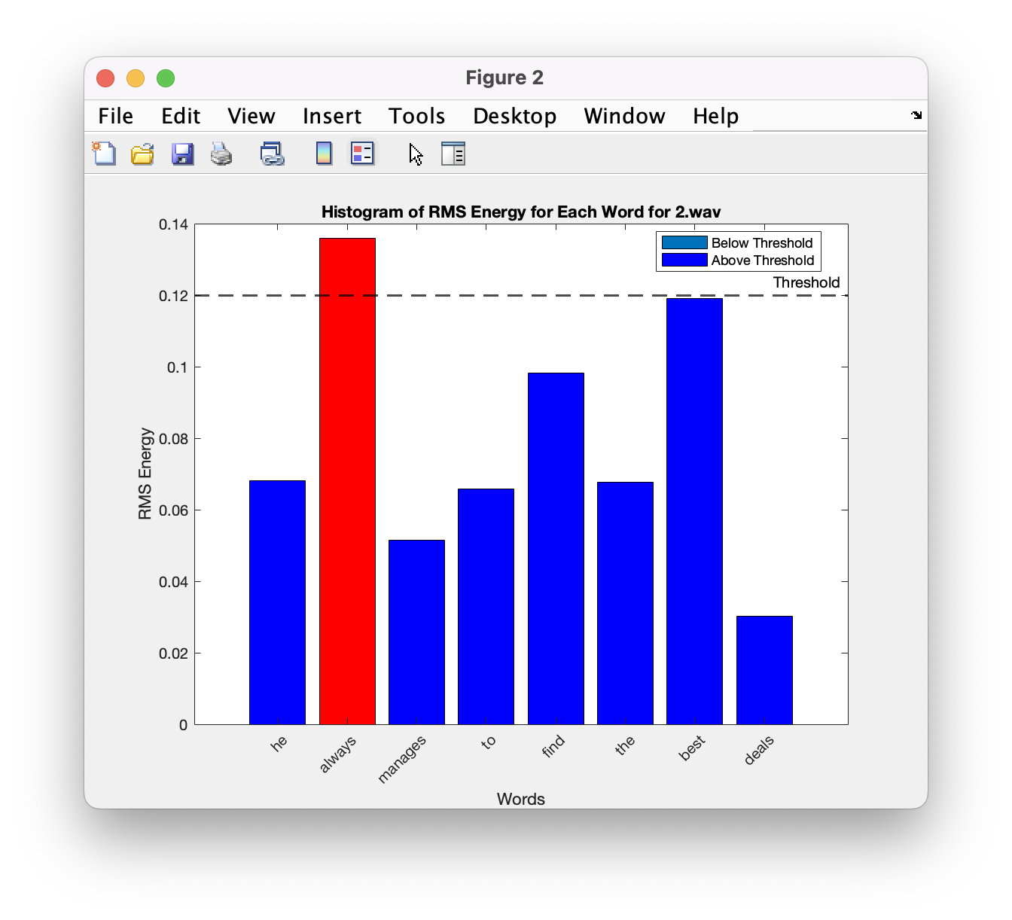
Task-1 results

Slide 21
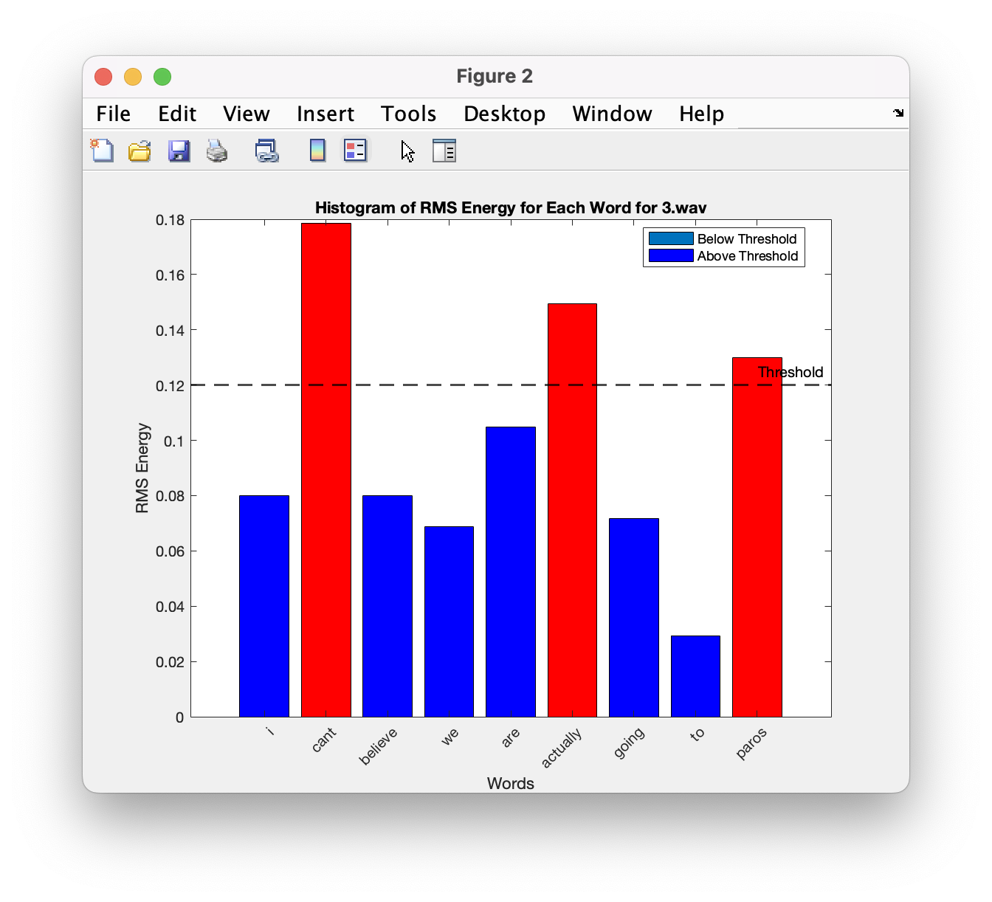
Task-1 results

Slide 22
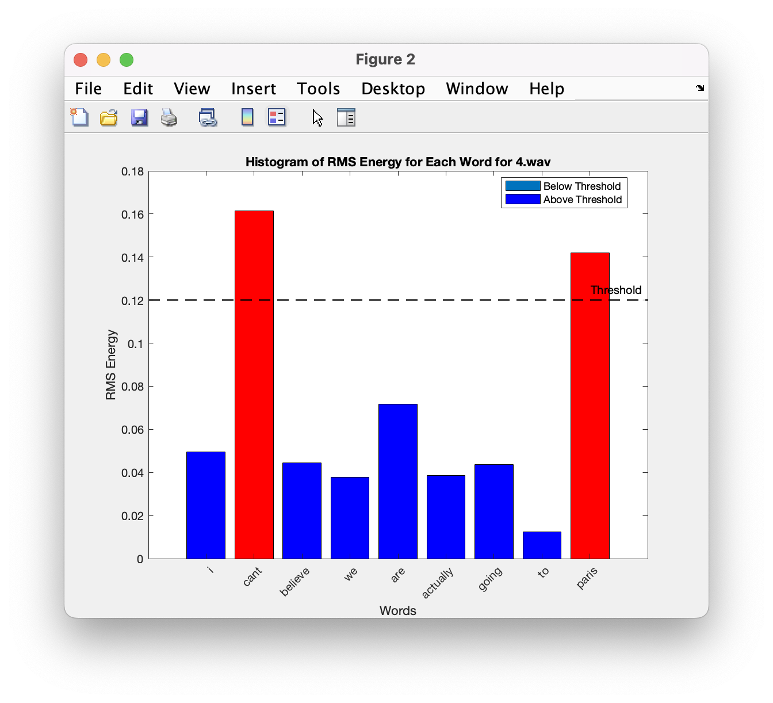
Task-1 results

Slide 23
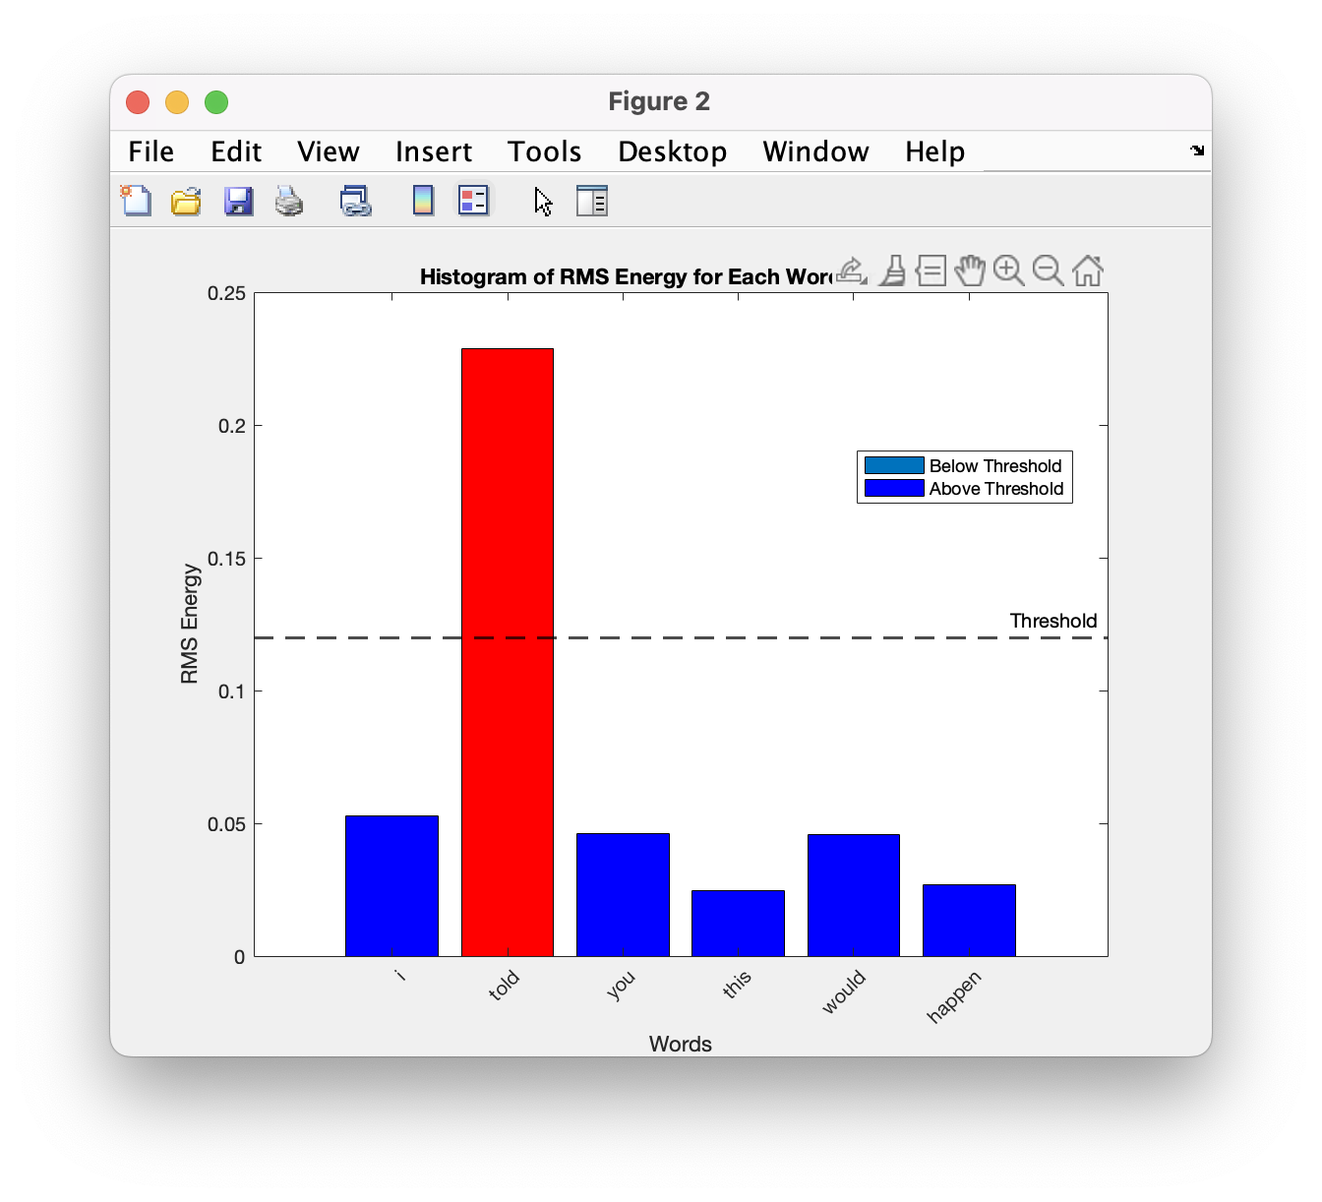
Task-1 results

Slide 24
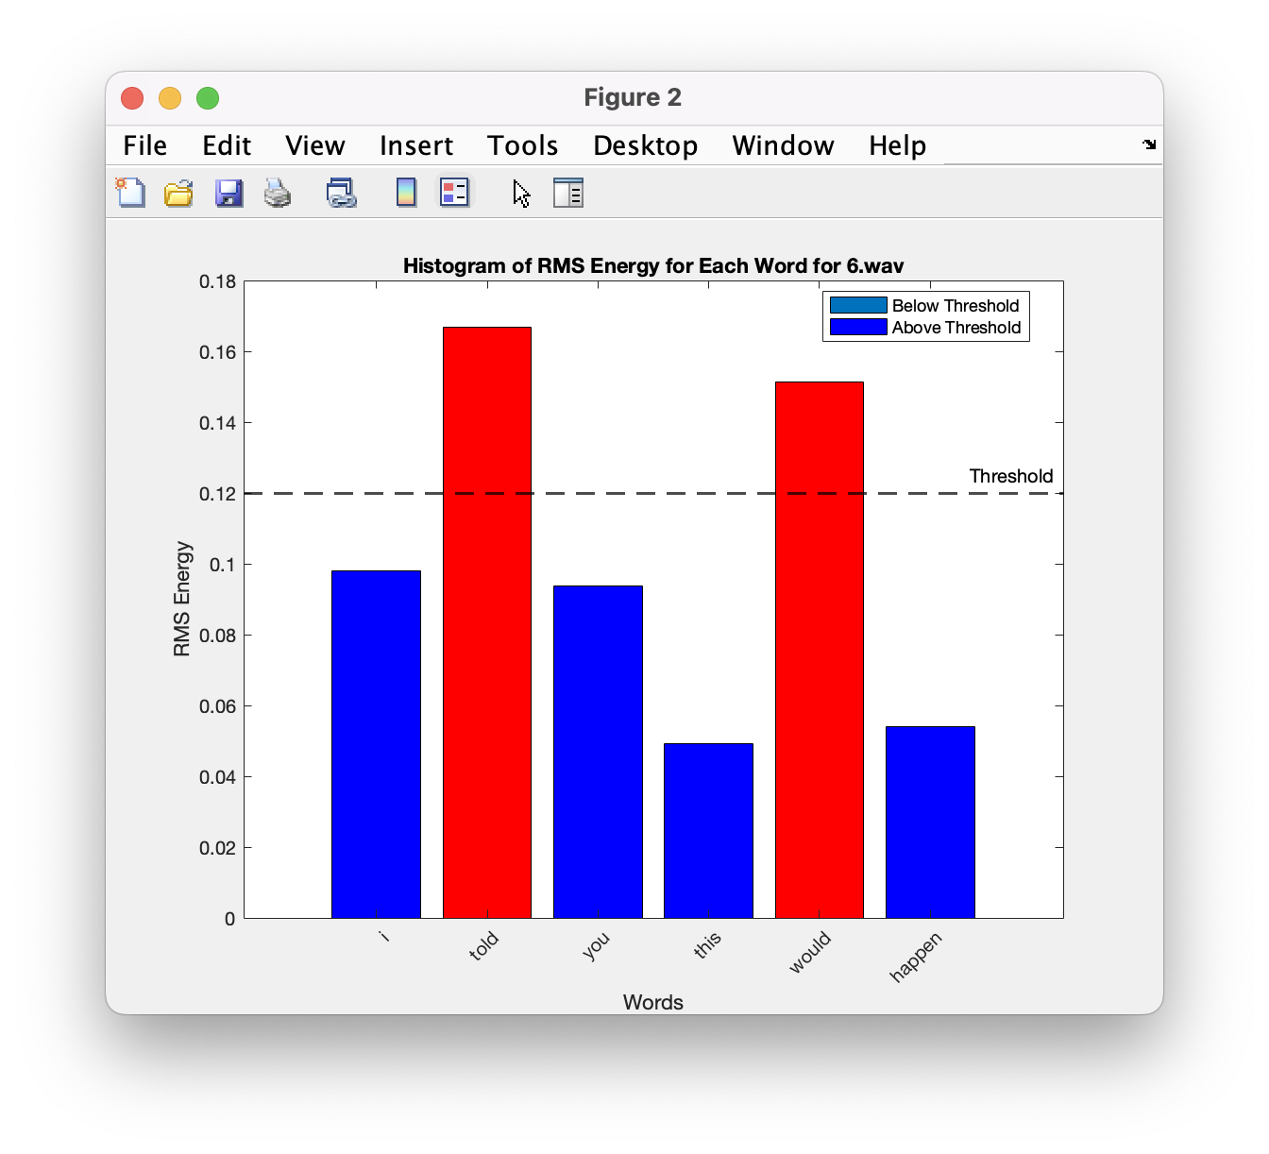
Task-1 results

Slide 25
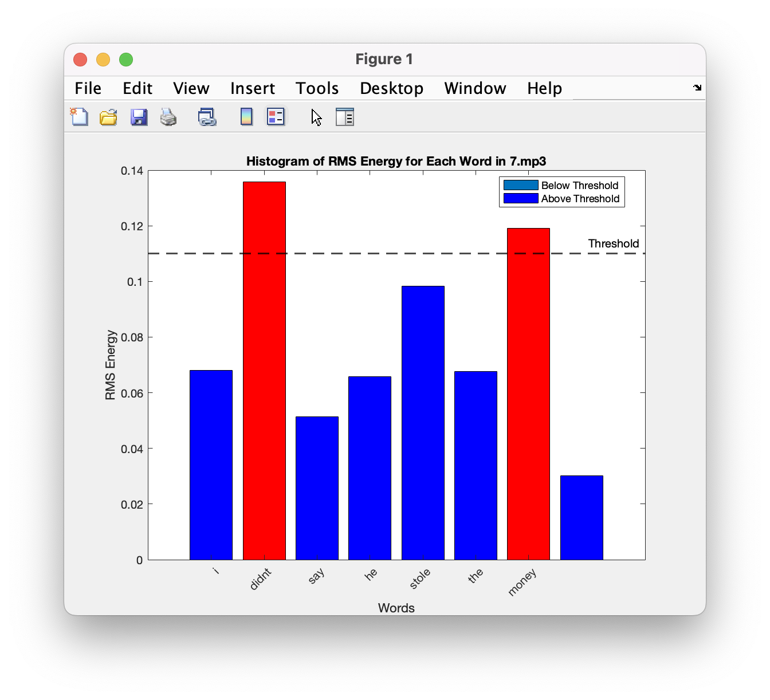
Task-1 results

Slide 26

Task-1 results

Slide 27
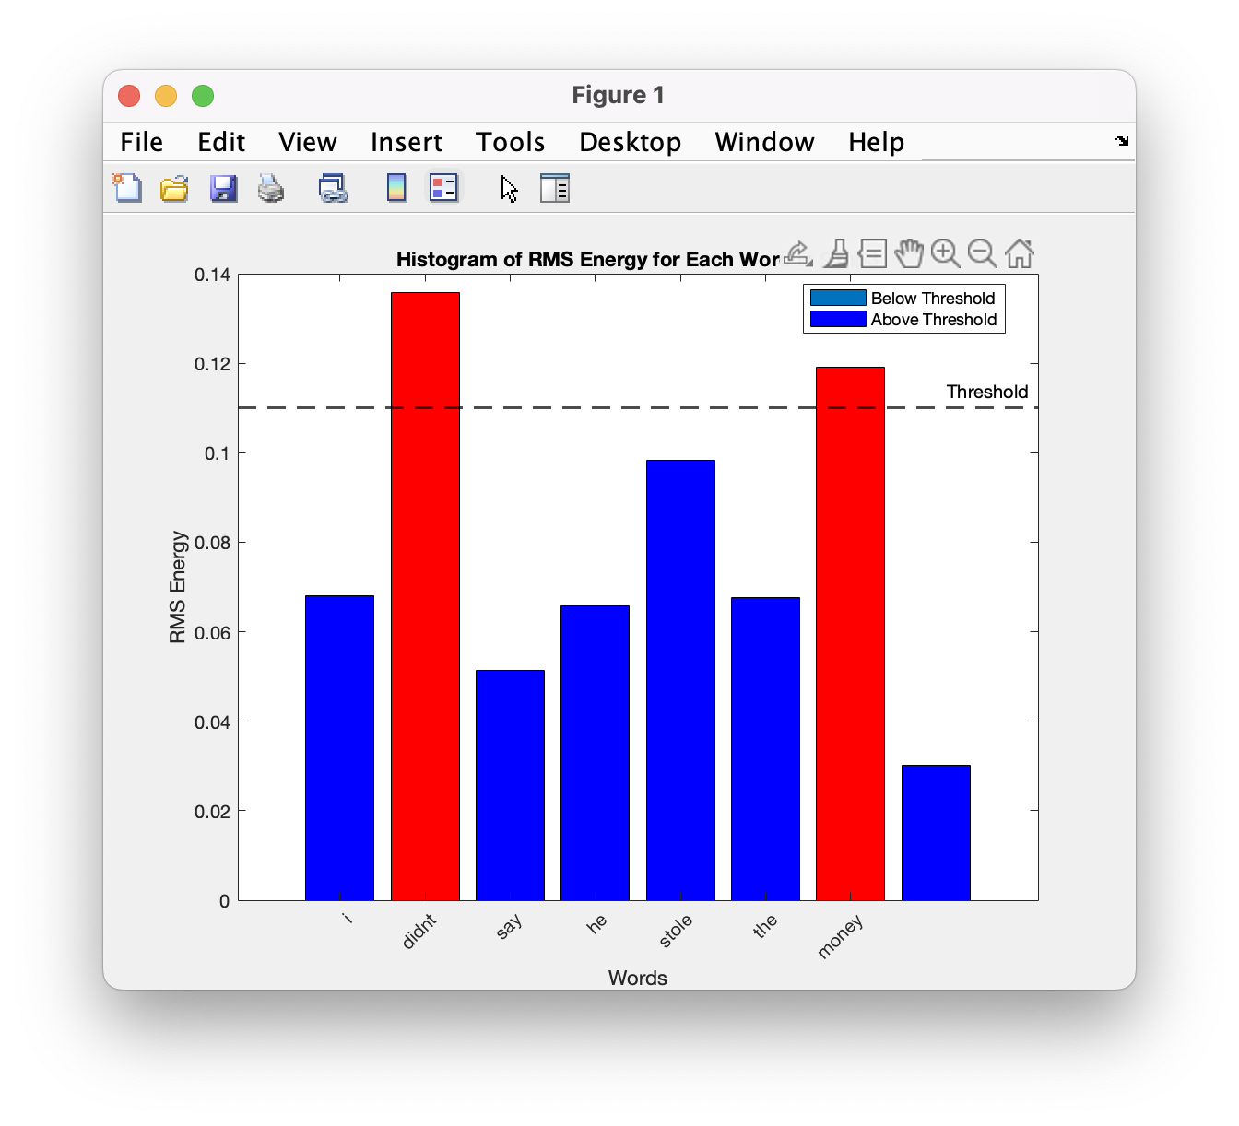
Task-1 results

Slide 28
Task-2

Slide 29
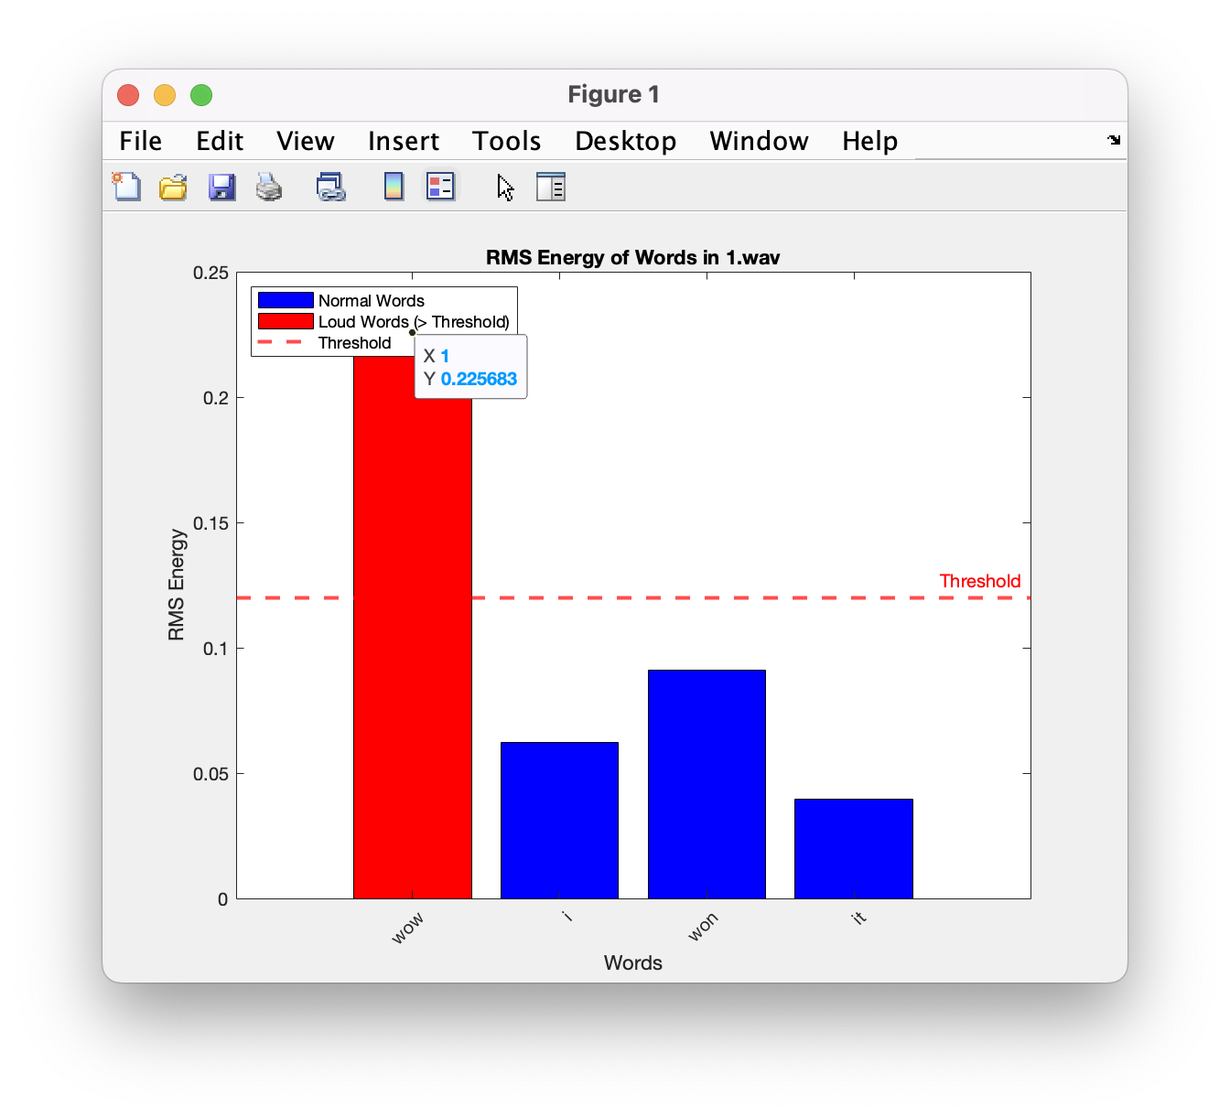
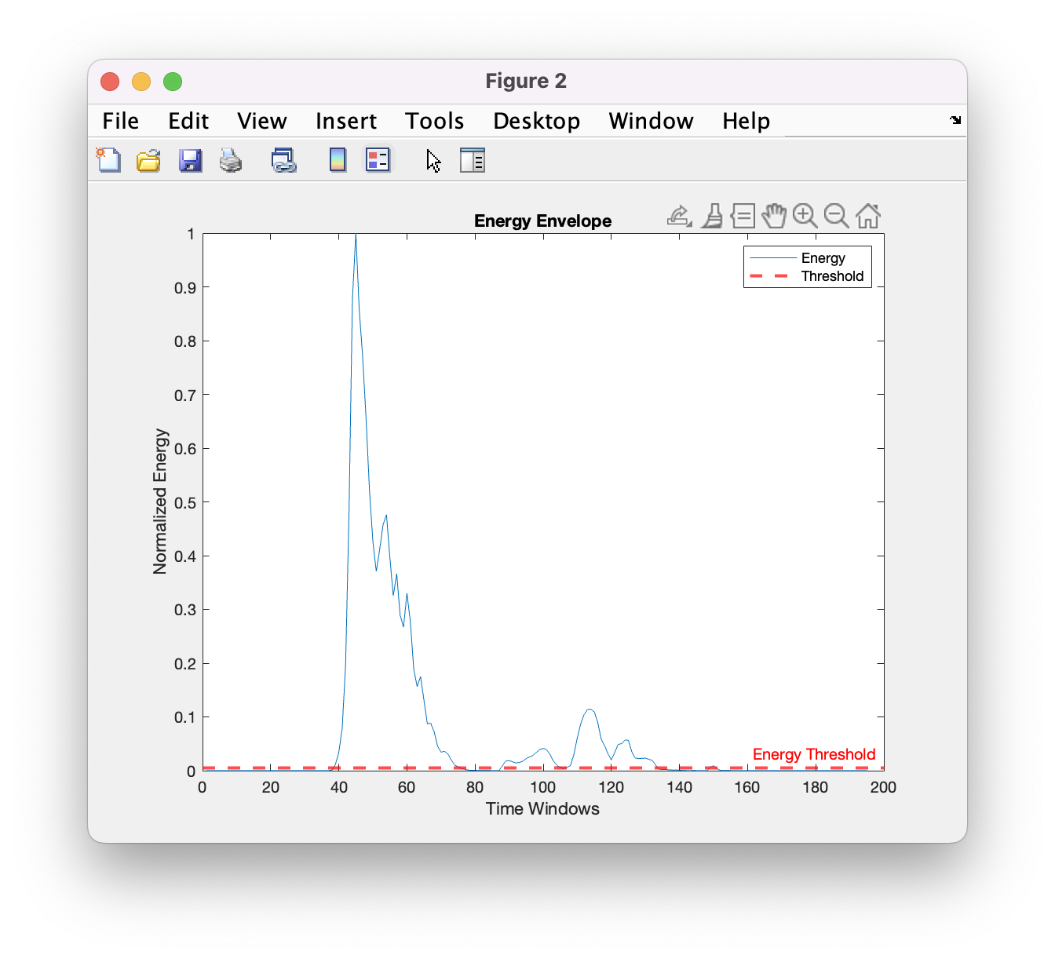
Task-2 results

Slide 30
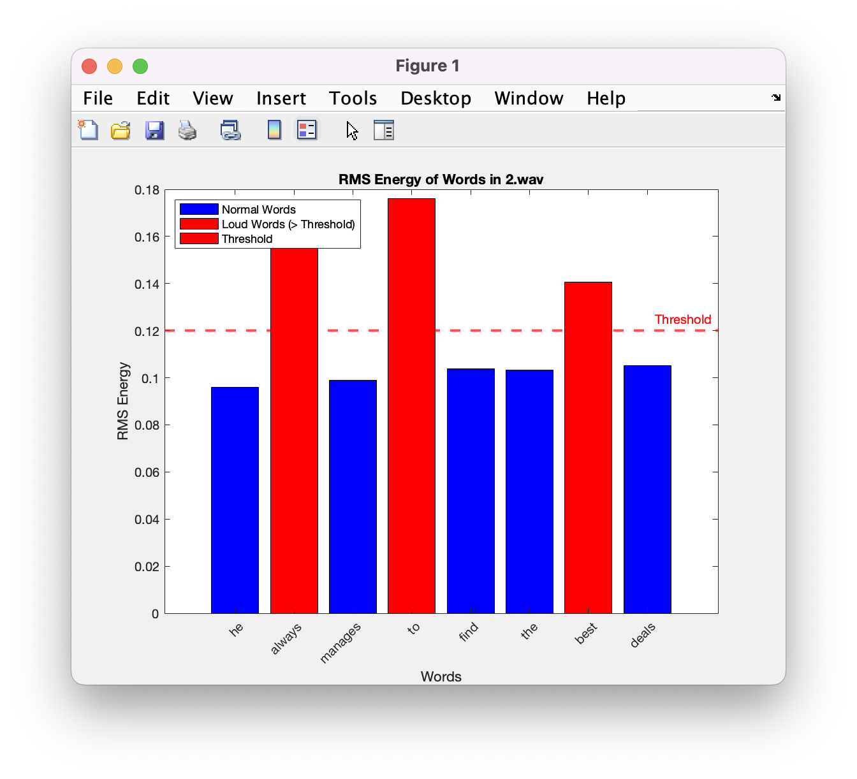
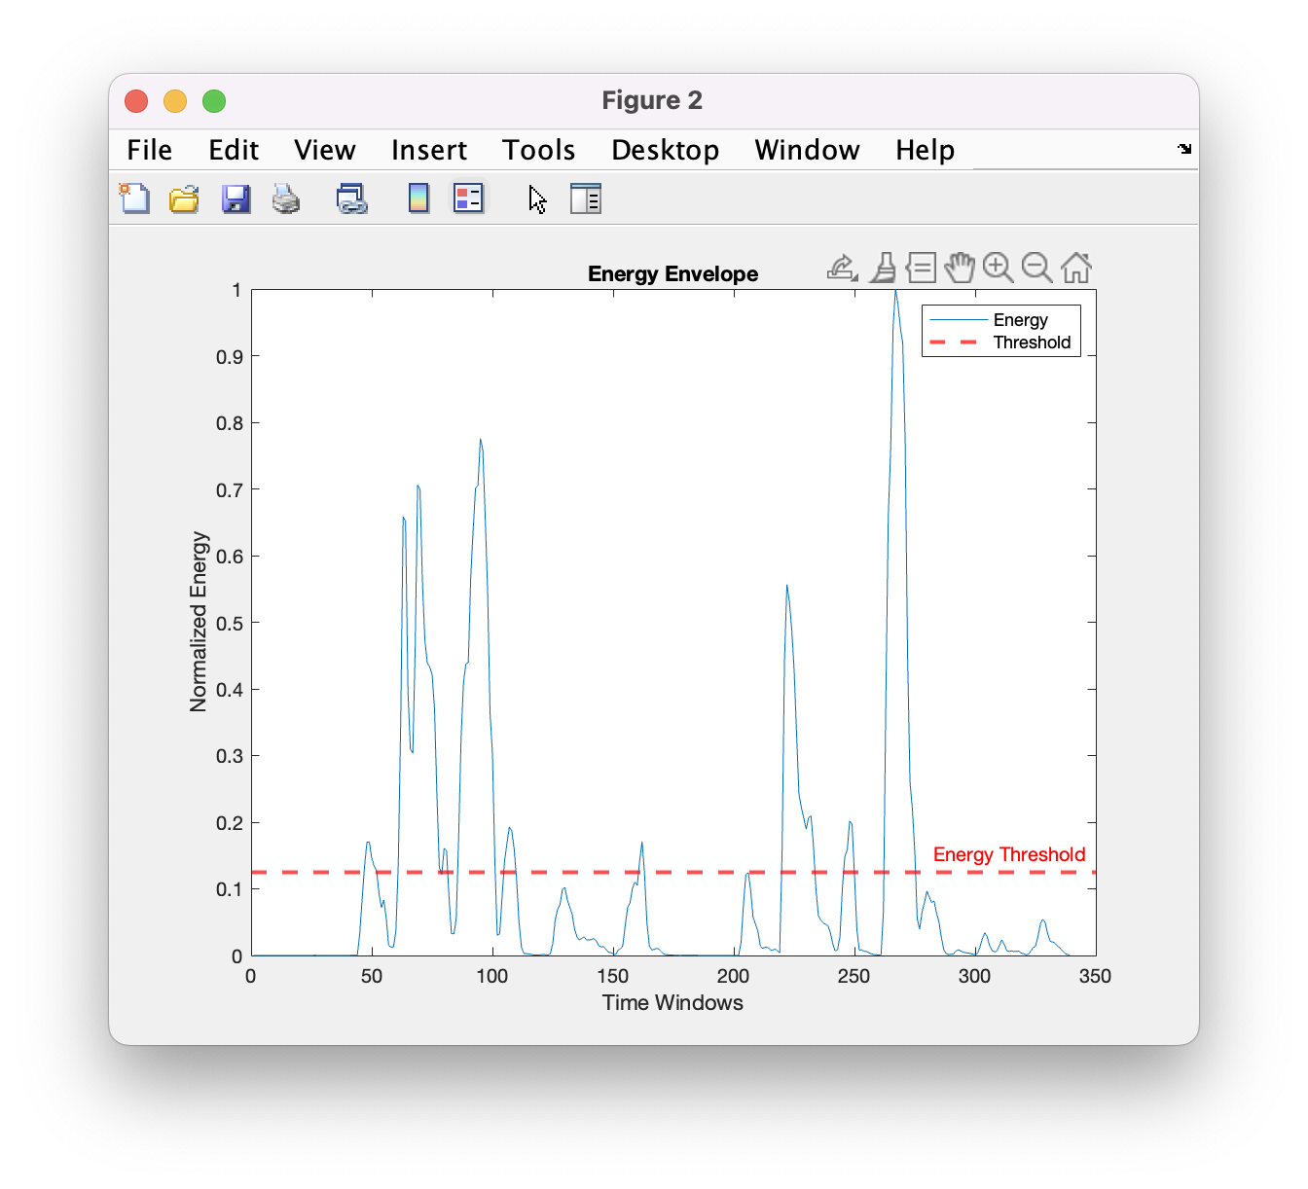
Task-2 results

Slide 31
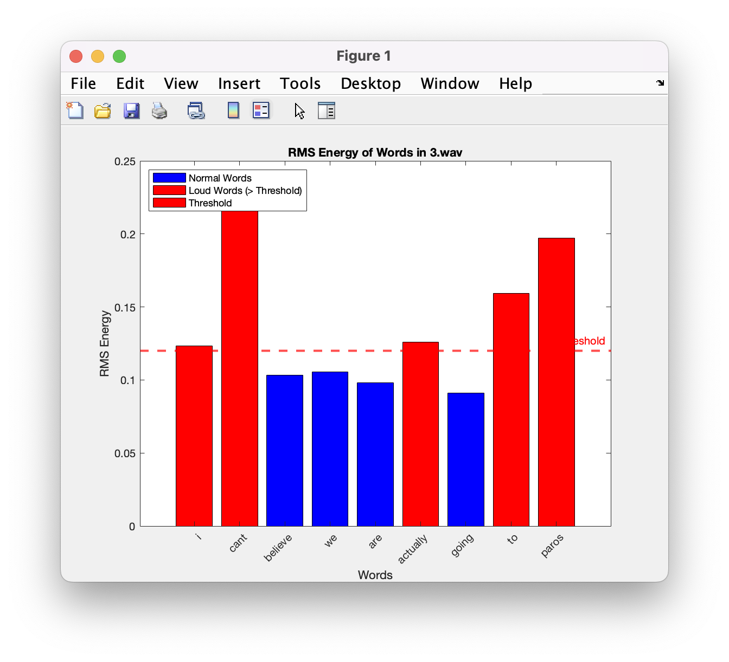
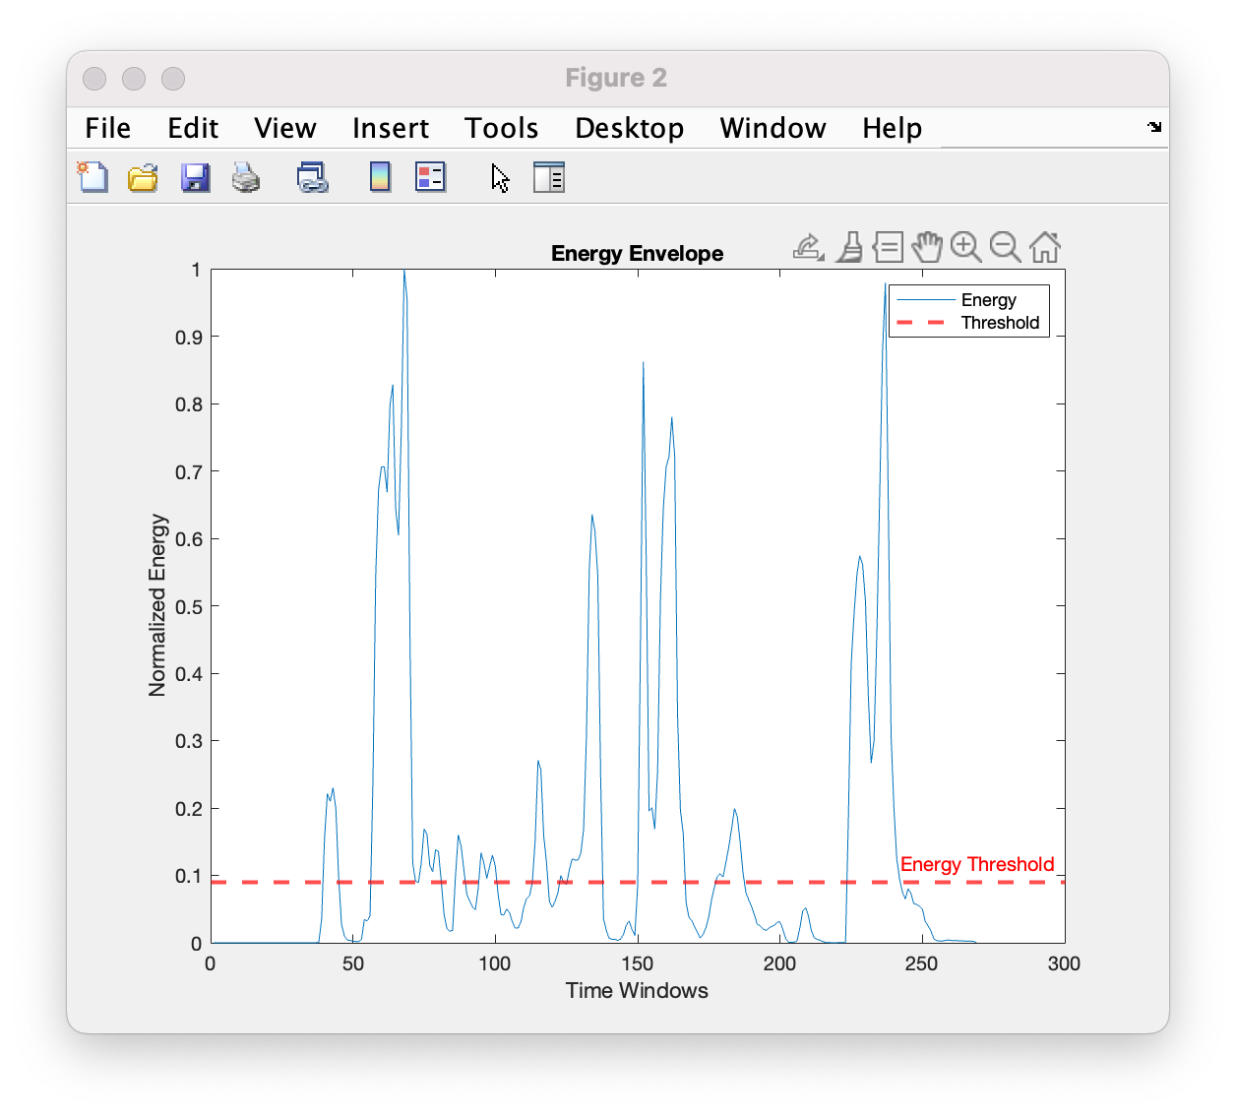
Task-2 results

Slide 32
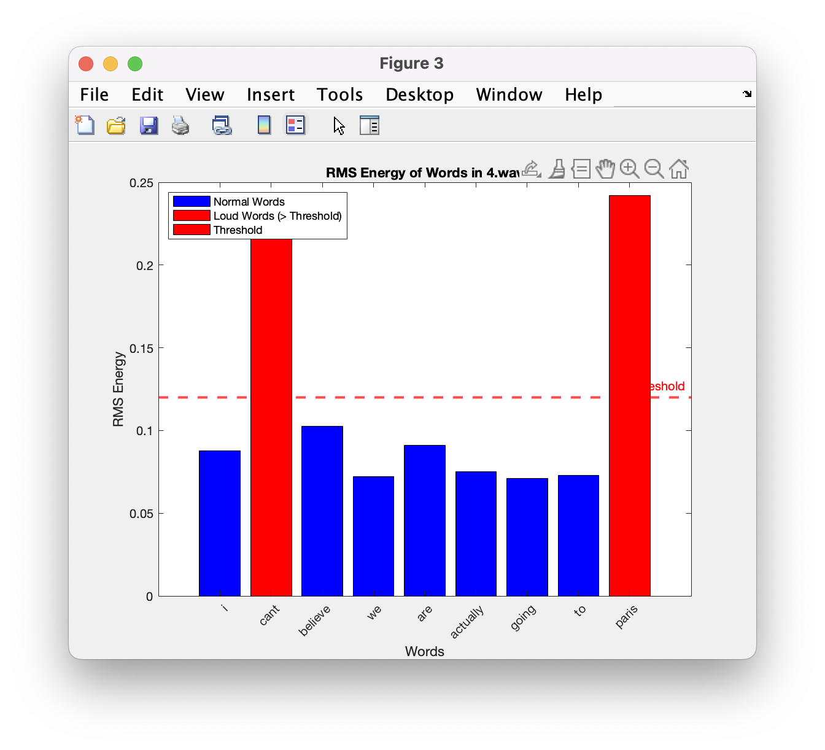
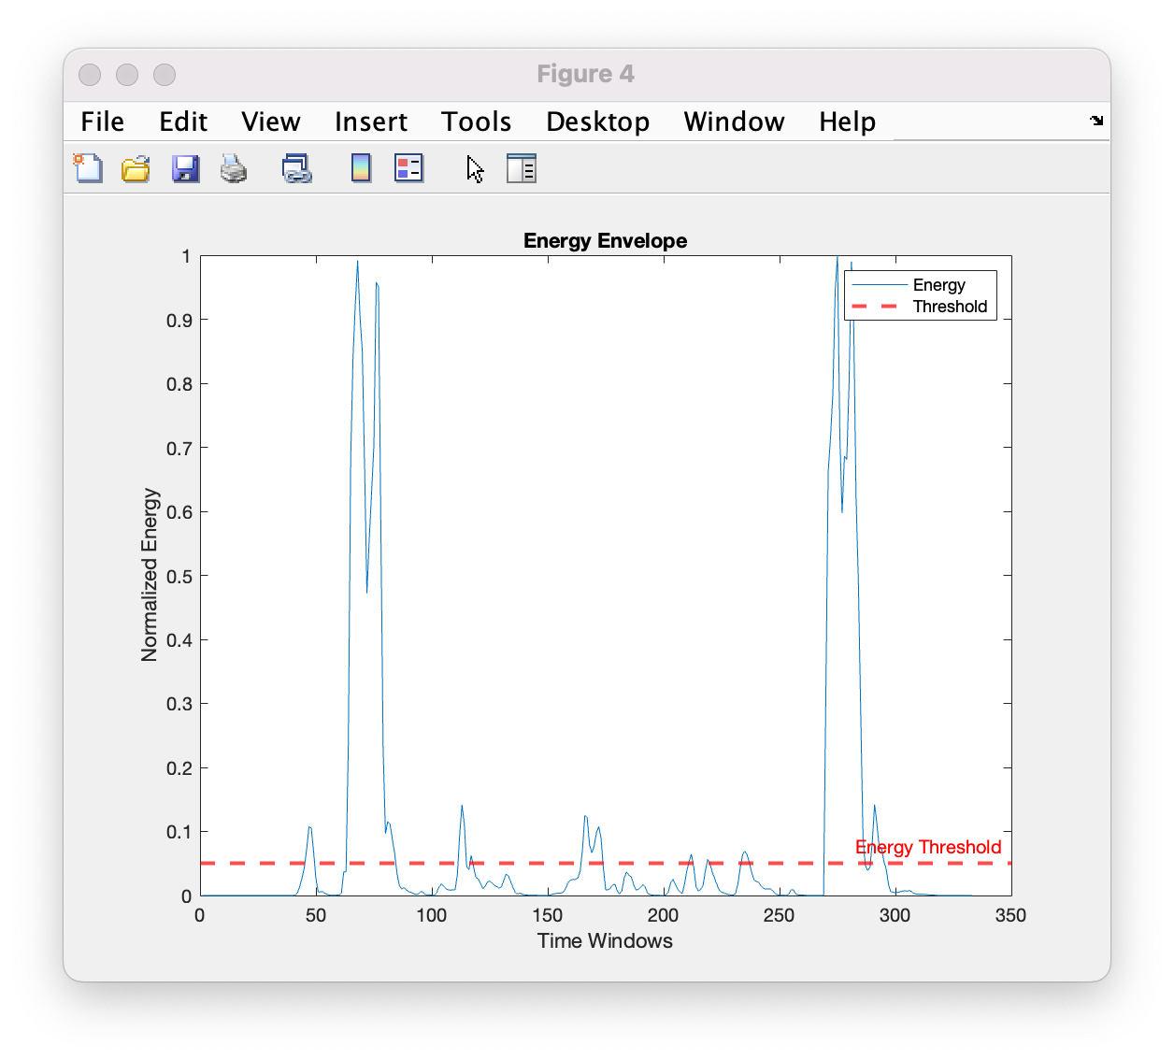
Task-2 results

Slide 33
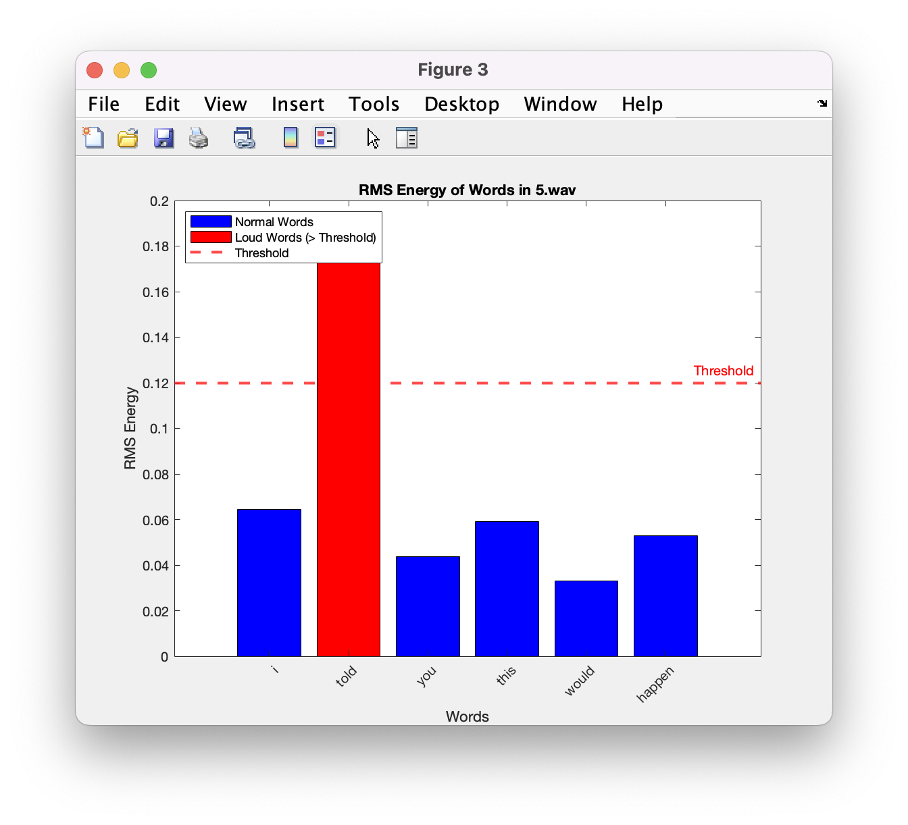
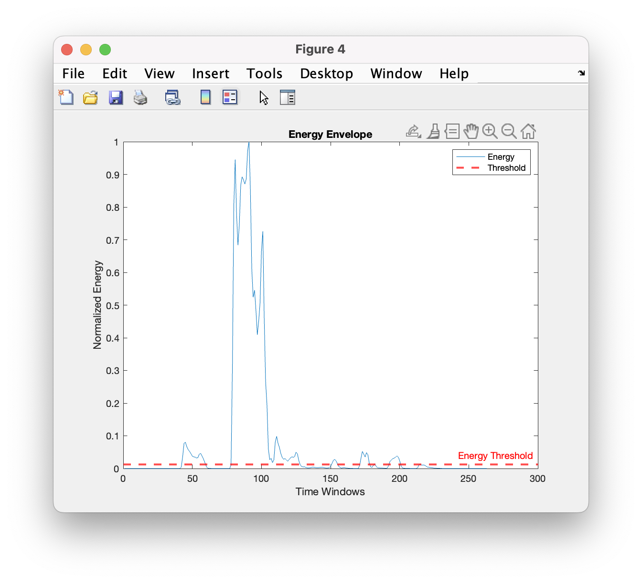
Task-2 results

Slide 34
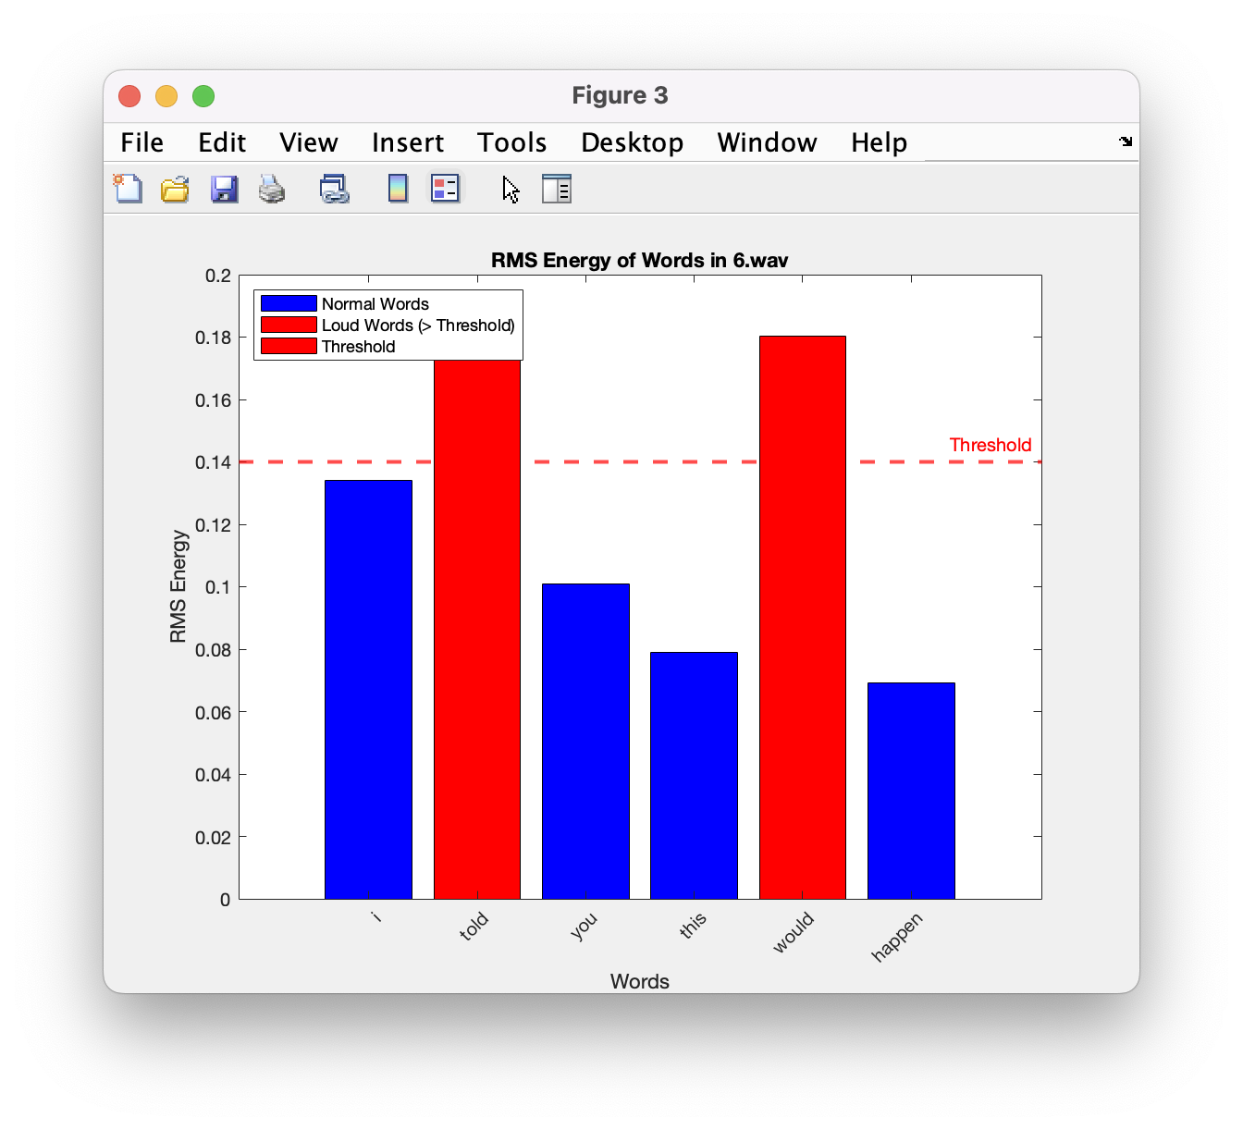
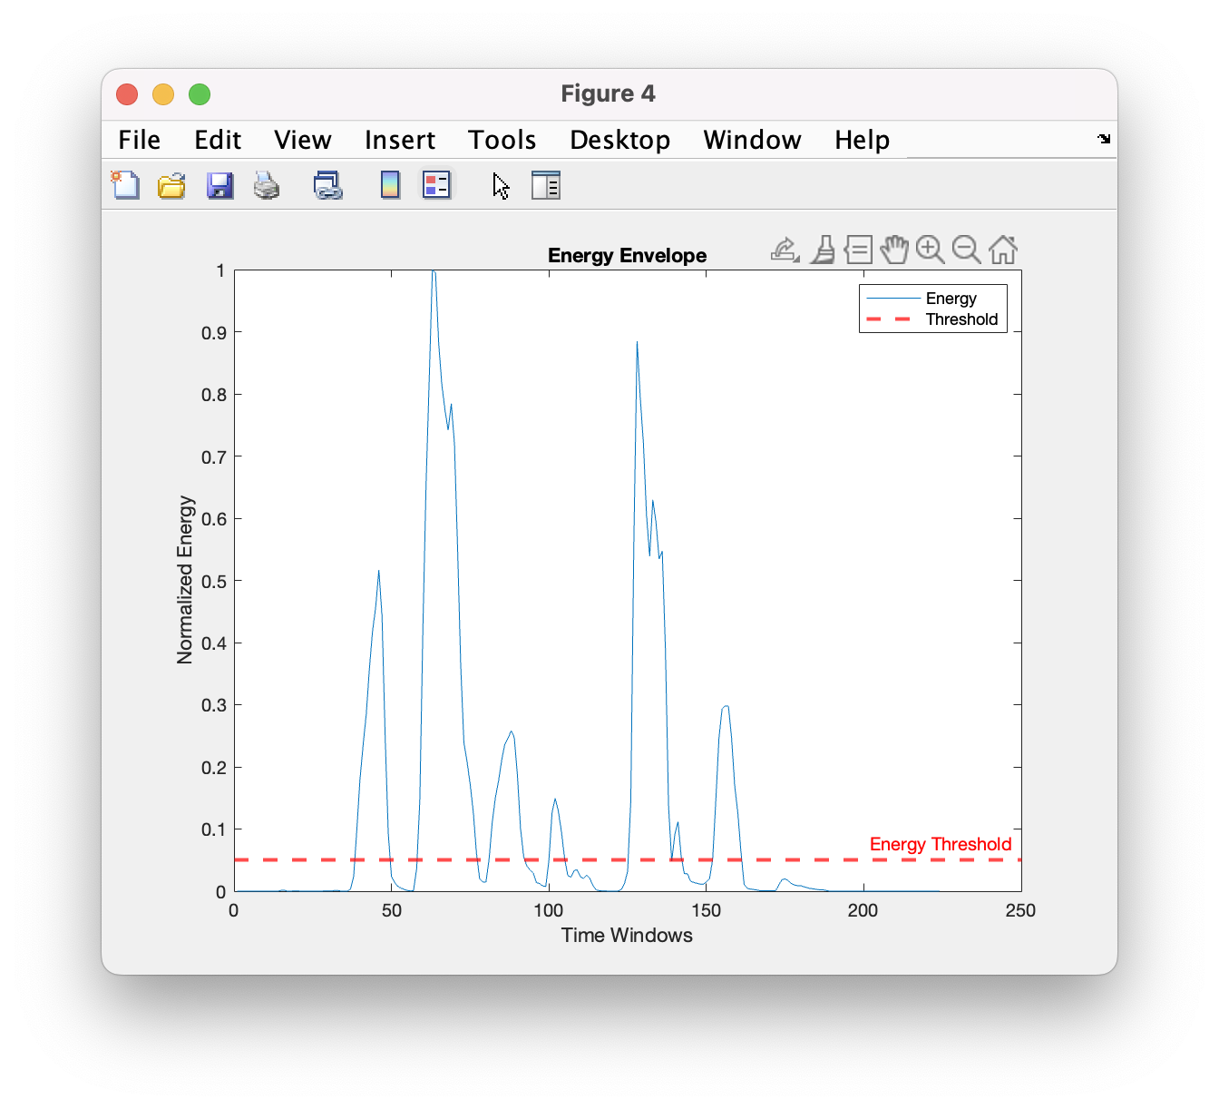
Task-2 results

Slide 35
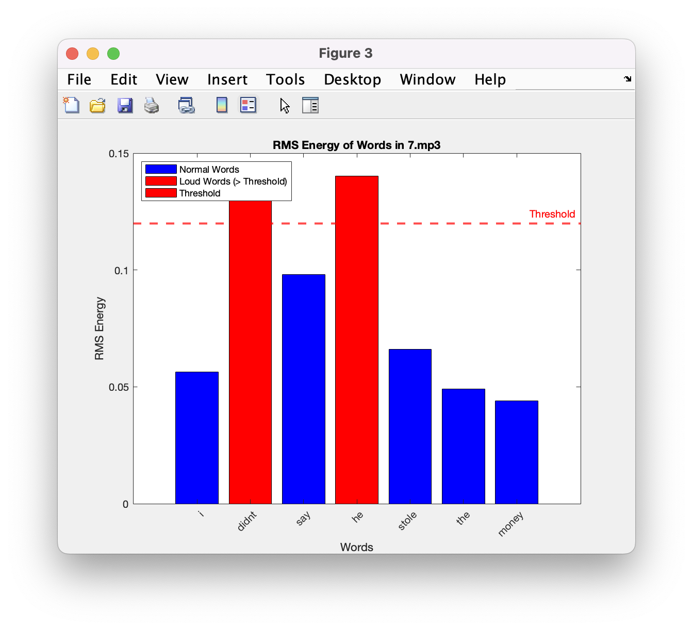
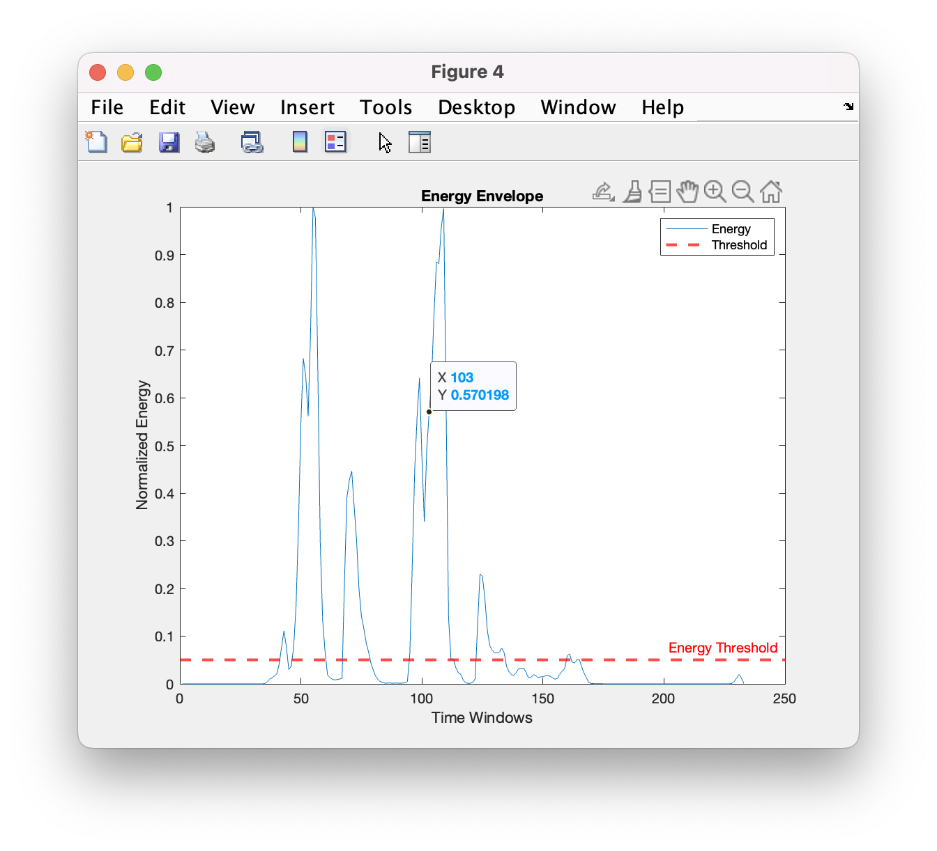
Task-2 results

Slide 36
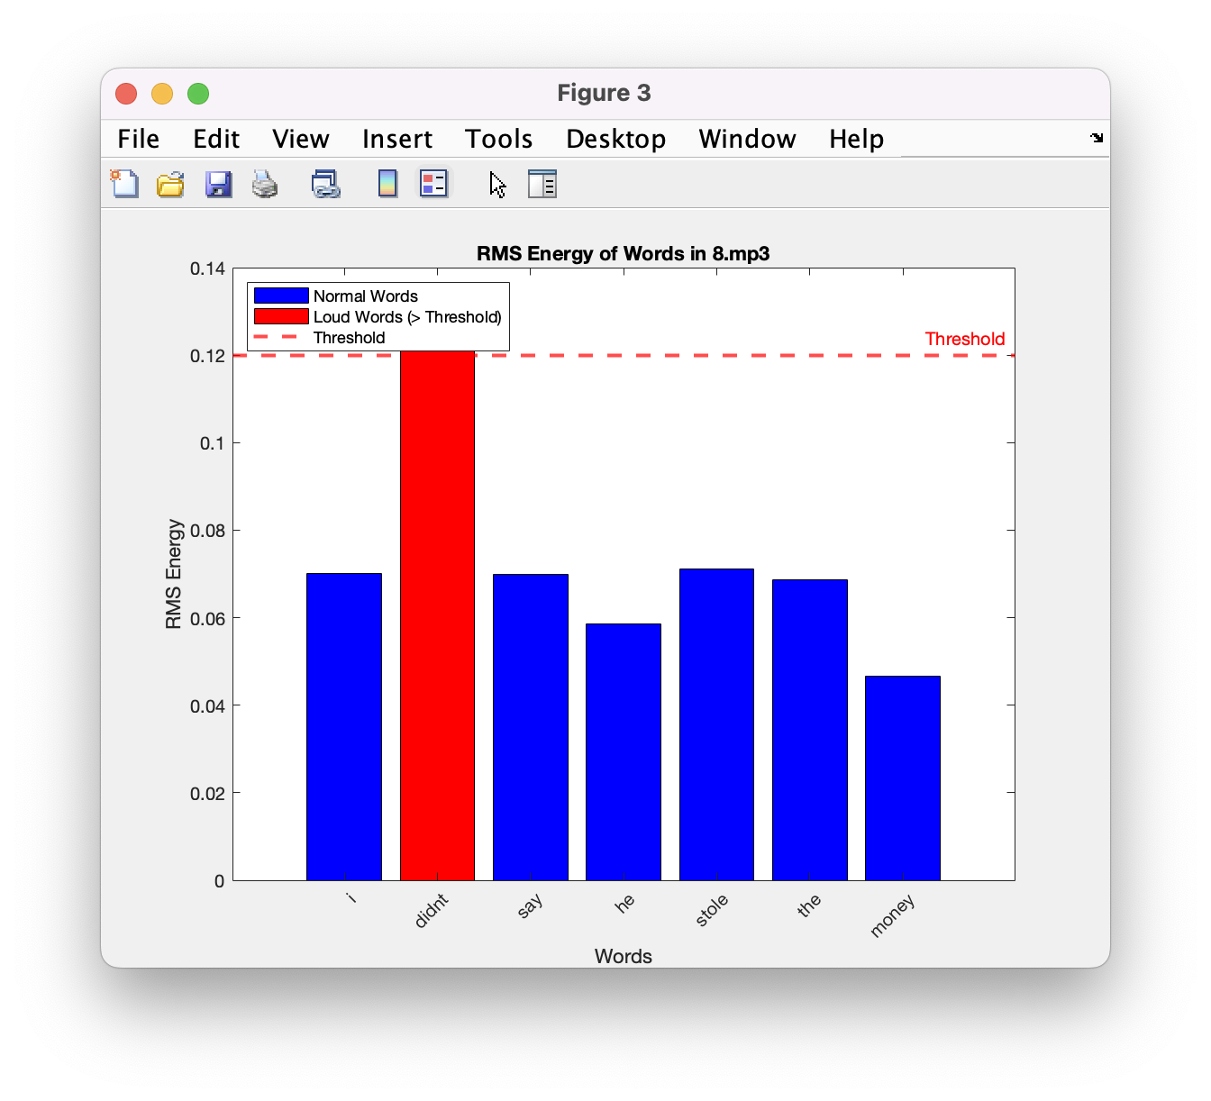
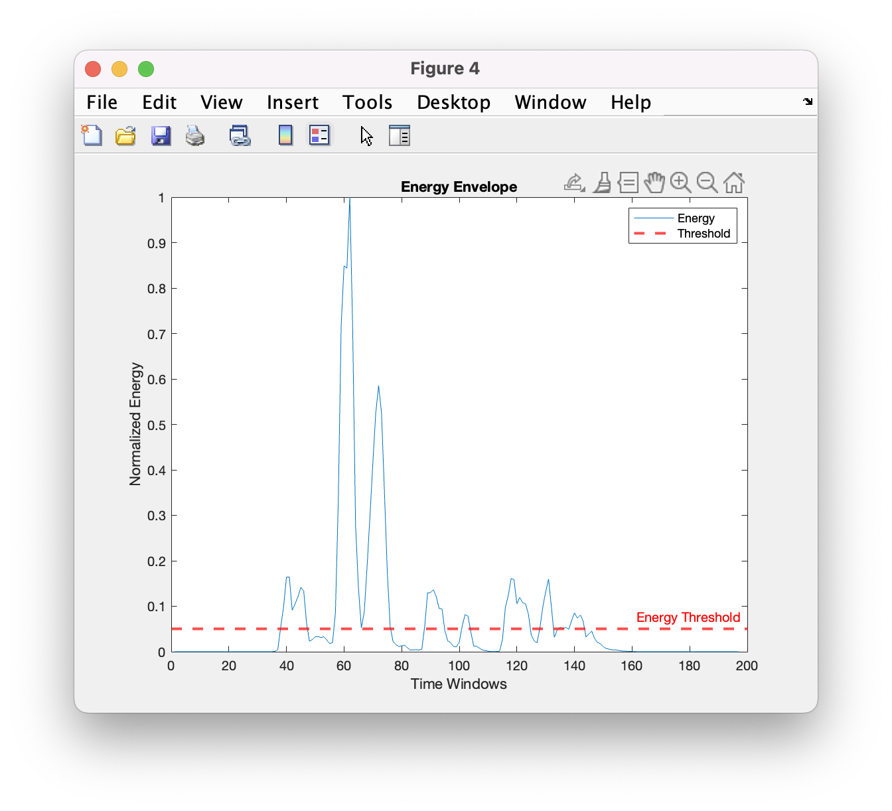
Task-2 results

Slide 37
Task-2 results

